Slide 1
Banquet Management System
Group 27

Slide 2
Topics
Introduction of the banquet system
Basic structure of the code
Setup the databases
Demonstration of how to use the banquet system
Attendee
Administrator

Slide 3
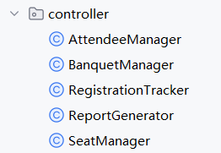
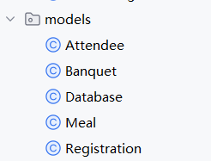
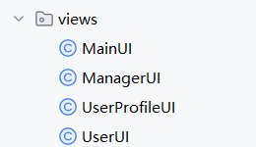

The Basic structures
Three Main modules
controller
models
views
-App(Program Entry)

Slide 4
Demonstration of how to use the banquet system
Attendee

Slide 5
Demonstration of how to use the banquet system
Administrator

Slide 6
Thank you!
group27

